Slide 1


Predicting E-Commerce Purchases Using Logistic Regression

Slide 2
Why Predict Purchase Behavior?
1
2
Optimize Marketing Spend
Streamline Inventory
Online retailers attract millions of visitors daily, yet only a fraction convert into buyers. Predicting who will buy helps allocate marketing resources more effectively, targeting high-potential customers and reducing wasted expenditure.
Understanding future purchase patterns allows for better inventory management, preventing stockouts of popular items and minimizing overstock of less desired products. This reduces holding costs and improves supply chain efficiency.
3
4
Enhance Customer Experience
Actionable Insights
Predictive models enable personalized recommendations and tailored user journeys, making the shopping experience more relevant and enjoyable for each individual. This fosters customer loyalty and increases satisfaction.
By transforming raw user data into actionable insights, businesses can proactively address customer needs, identify new growth opportunities, and make data-driven decisions that impact the bottom line.

Slide 3

What is Logistic Regression?
Logistic Regression is a powerful statistical model primarily used for predicting binary outcomes. In the context of e-commerce, this means forecasting whether a user will perform one of two actions: either "buy" (represented as 1) or "not buy" (represented as 0).
At its core, Logistic Regression employs a sigmoid (or logistic) function. This S-shaped curve transforms any real-valued input into a probability, making it ideal for classification tasks. It maps the linear combination of features to a value between 0 and 1, which can then be interpreted as a probability score.
This model utilizes various features related to the customer and the product to estimate the probability of a purchase. This probability is a score between 0 and 1, indicating the likelihood of a conversion.

Slide 4




Key Features Influencing Purchase Prediction
User Demographics
Behavioral Data
Information such as age, gender, geographic location, and even inferred income levels can significantly influence purchasing decisions. Different demographic groups often exhibit distinct buying behaviors and preferences.
Actions on the website are crucial predictors. This includes metrics like browsing time on specific pages, the number of page views, items added to the shopping cart, wish list additions, and previous purchase history.
Product Attributes
Temporal Factors
Characteristics of the product itself play a vital role. Factors such as price, customer reviews and ratings, stock availability, product category, and even color or size options can sway a purchase decision.
Timing can be everything. This includes the day of the week, time of day, session length, the recency of the last visit, and whether the purchase aligns with holidays or promotional periods.

Slide 5
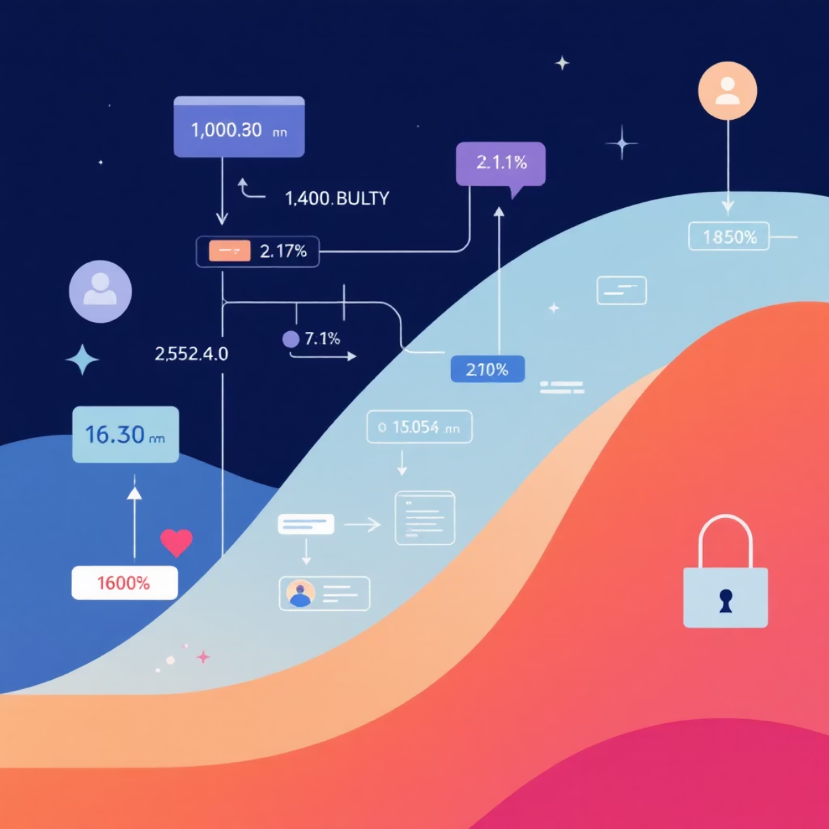
How Logistic Regression Works in E-Commerce
Logistic regression operates by assigning a specific "weight" to each feature. These weights quantify the importance and direction of each feature's influence on the likelihood of a purchase. For instance, a higher positive weight on "browsing time" indicates that longer browsing sessions increase purchase probability.
Once weights are assigned, the model calculates a combined score using these weighted features. This raw score is then passed through the sigmoid function, transforming it into a probability value between 0 and 1.
For example, if a user spends more time on a product page, reads several positive reviews, and adds the item to their cart, these actions are weighted positively. The combined score, when put through the sigmoid function, would result in a significantly higher purchase probability, signaling a strong intent to buy.

Slide 6
Real-World Impact: Case Studies
Furniture Retailer: Intent Signals
Online Bookstore: Engagement & Conversion
Targeted Discounts & Personalization
A prominent online furniture retailer discovered that customers who viewed a specific sofa product page three or more times within a single week had a 70% higher likelihood of making a purchase. This insight allowed them to target these highly engaged users with personalized offers and retargeting campaigns, significantly boosting conversion rates for high-value items.
Many e-commerce platforms now leverage logistic regression predictions to offer targeted discounts, personalized product recommendations, and customized email campaigns. By identifying users with high purchase probability for certain items, they can deliver highly relevant incentives, resulting in higher conversion rates and increased average order value.
An analysis by an online bookstore revealed a strong correlation between browsing duration and purchase intent. For every additional minute a user spent browsing book categories or specific titles, their odds of making a purchase increased significantly. This led to strategies focused on enriching content and improving site navigation to encourage longer engagement.

Slide 7
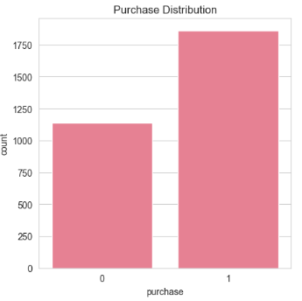
E-commerce purchase behavior analysis:
Purchase Distribution:
What it shows: The count of sessions that resulted in a purchase (1) versus those that did not (0).
Key Insight: The number of sessions resulting in a purchase (over 1,750) is higher than the number of non-purchase sessions (around 1,250). This indicates a strong baseline conversion rate for the observed period, suggesting the website is effective at converting visits into sales.

Slide 8
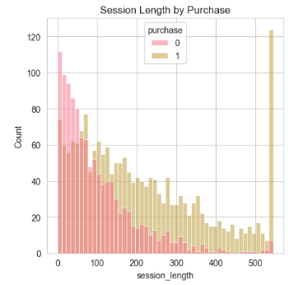
2. Session Length by Purchase
What it shows: The distribution of session lengths (in seconds) for both purchasing (1, pink) and non-purchasing (0, yellow) sessions.
Key Insight:
Purchasers have longer sessions: While most sessions are short, the distribution for purchasing sessions (pink) is visibly shifted to the right and has a longer, heavier tail compared to non-purchasing sessions (yellow).
Actionable Takeaway: Customers who spend more time on the site are significantly more likely to convert. Focus on content/features that increase time-on-site for prospective buyers.

Slide 9
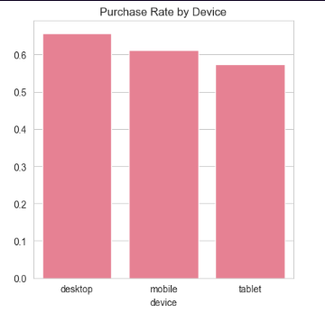
3. Purchase Rate by Device
What it shows: The conversion rate (purchase probability) segmented by the device used (desktop, mobile, tablet).
Key Insight:
Desktop leads conversion: Sessions from desktop devices have the highest conversion rate (over 0.65), closely followed by mobile (around 0.61) and tablet (around 0.58).
Actionable Takeaway: While mobile conversion is high, there is a slight gap compared to desktop. Prioritize investigating and optimizing the mobile and tablet user experience to close this conversion gap.

Slide 10
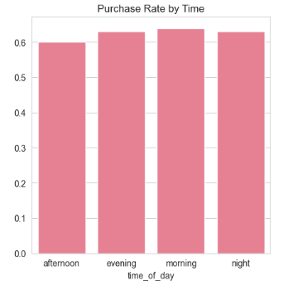
4. Purchase Rate by Time
What it shows: The conversion rate across four time segments: afternoon, evening, morning, and night.
Key Insight: The conversion rate is remarkably consistent across all times of the day, hovering just above 0.60 for all segments. This suggests that user intent and purchase probability are not heavily dependent on the time of day.

Slide 11
Advantages of Logistic Regression for E-Commerce
Simplicity & Interpretability
Efficiency in Deployment
Logistic Regression offers a clear and understandable model. It explicitly shows how each feature (e.g., browsing time, price, demographics) contributes to the purchase decision, making it easy for business stakeholders to grasp the underlying logic and trust the predictions.
The model is computationally efficient, allowing for rapid training and deployment even with large datasets. This makes it suitable for real-time applications in e-commerce, such as dynamic pricing adjustments or immediate recommendation generation.
Probabilistic Outputs
Foundation for Nuanced Strategies
Unlike some models that provide only a binary outcome, logistic regression outputs a probability score. This nuanced information enables more sophisticated strategies, such as segmenting customers by their likelihood to buy, or prioritizing marketing efforts based on confidence levels.
The probabilistic nature of the output allows e-commerce businesses to develop highly targeted and segmented marketing strategies. This could include offering varying levels of discounts, triggering different communication flows, or optimizing ad placements based on predicted purchase likelihood.

Slide 12


Challenges and Considerations
Imbalanced Data
Dynamic User Behavior
Feature Engineering
In e-commerce, the number of users who browse far outweighs those who actually make a purchase. This imbalanced dataset requires specialized techniques like oversampling, undersampling, or using specific evaluation metrics (e.g., precision, recall, F1-score) to prevent the model from becoming biased towards the majority class (non-buyers).
Customer preferences and online trends change rapidly. Models need frequent updates and retraining to remain relevant and accurate. A model trained on last year's data might not capture current buying patterns, necessitating robust MLOps practices for continuous monitoring and deployment.
The quality of predictions heavily relies on the quality and relevance of the input features. Extracting meaningful signals from complex, raw data (e.g., raw clickstream logs, text reviews) requires extensive domain knowledge and creative feature engineering to build effective predictive power.

Slide 13



Beyond Logistic Regression: Hybrid Approaches
While logistic regression is a robust and interpretable model, its predictive power can sometimes be limited by the linearity assumption. To overcome this, combining it with other machine learning techniques often leads to superior performance.
Ensemble Modeling
Combining logistic regression with more complex models like decision trees or random forests can create powerful ensemble models. Logistic regression might act as a "meta-learner" on the outputs of other models, or the models could be stacked in sequence to leverage different strengths.
Balancing Interpretability & Power
Hybrid approaches allow businesses to strike a balance between model interpretability (often a strength of logistic regression) and predictive accuracy (where more complex models might excel). This ensures that while predictions are strong, the insights remain actionable and explainable.
Continuous Experimentation
The dynamic nature of e-commerce necessitates an iterative approach. Continuous experimentation with different model combinations, feature sets, and tuning parameters is crucial to discover and maintain the optimal predictive solution for ever-evolving customer behavior.

Slide 14
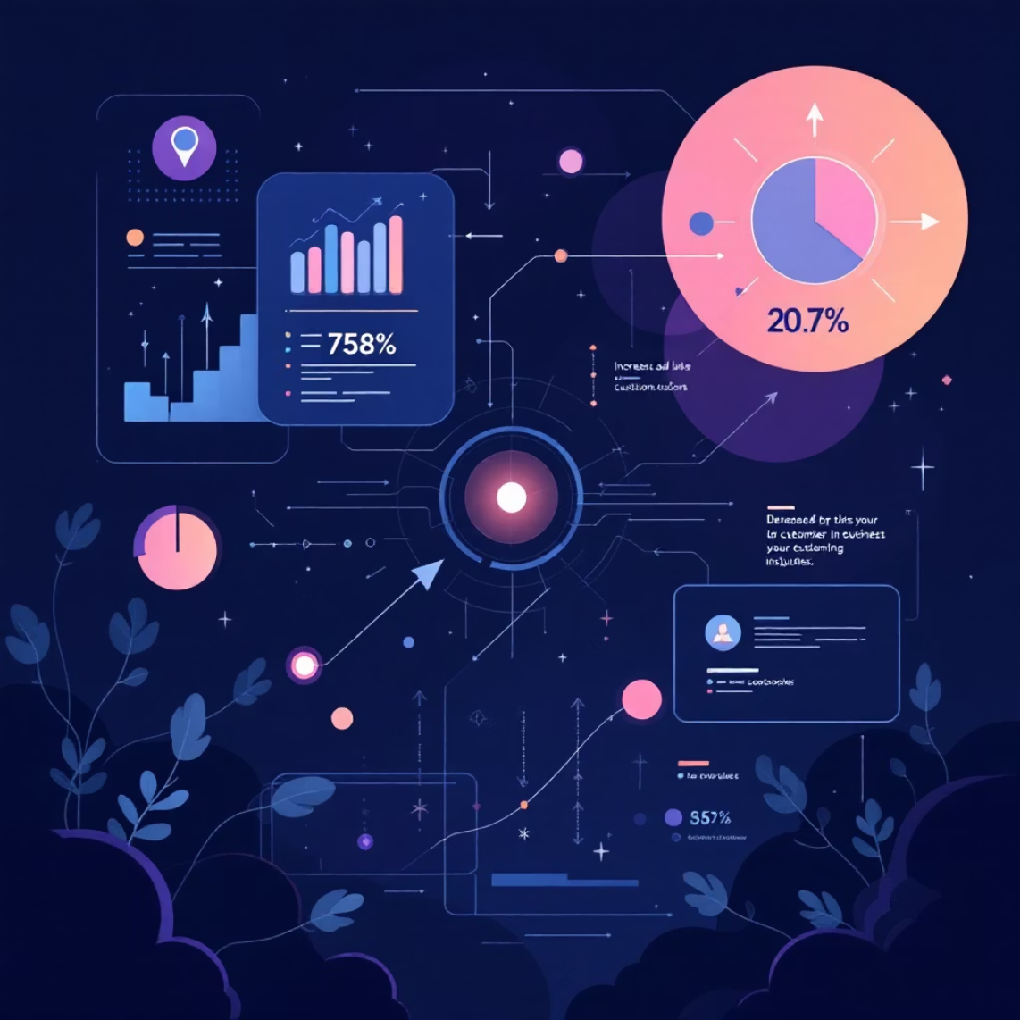
Conclusion: Turning Data into Decisions
Logistic regression stands as a fundamental tool, empowering e-commerce platforms to accurately predict who among their vast user base is most likely to make a purchase, and at what crucial moment.
This predictive capability translates directly into tangible business benefits: enabling smarter, more targeted marketing campaigns that resonate with potential buyers, optimizing inventory levels to meet demand efficiently, and crafting highly personalized shopping experiences that foster customer loyalty.
In today's fiercely competitive digital marketplace, investing in robust predictive analytics is no longer a luxury but a strategic imperative. It is the key to unlocking growth, optimizing operations, and staying ahead by making data-driven decisions that propel businesses forward.

